Slide 1

DRY BEAN CLASSIFICATION SYSTEM
Project Supervisor: Dr.A.CHRISTY,MCA.,Ph.D
Name of the Student: Karthick B
Register Number: 39110465

Slide 2
Presentation Outline
Course Certificate
Introduction
Objectives
System Architecture / Ideation Map
Module Implementation
Application Snapshots
Results and Discussions
Conclusion
References

Slide 3
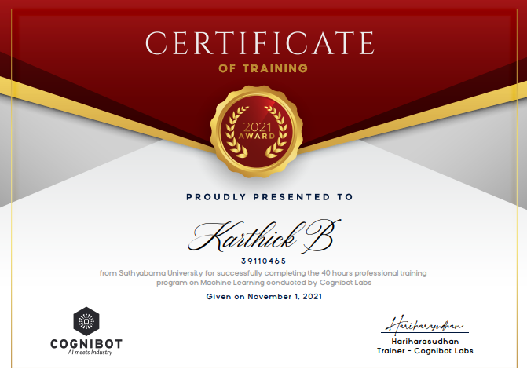
Course Certificate

Slide 4
Introduction
There are many kinds of beans present in this world.
It is very difficult to classify them even with naked eyes as they share very little difference in appearance.
So classifying the beans is a bit tougher than one can imagine.

Slide 5
Objectives
Predict the class of Beans.
Study the classification of Beans from the given data.
Predict the class of Dry Beans by using different macine learning algorithms.
Checking which algorithm has the best accuracy.

Slide 6
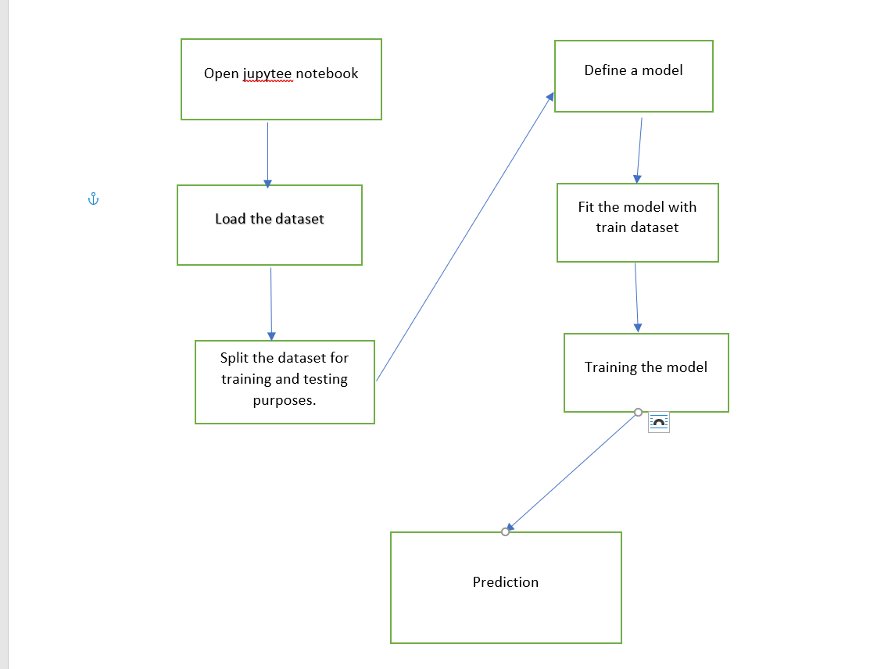
System Architecture / Ideation Map

Slide 7
Project Implementation
SOFTWARE REQUIRED.
Jupyter Notebook.
Packages Required.
Pandas.
Sklearn.
Matplotlib.

Slide 8
Module defination
PANDAS
Pandas is one of the tools in Machine Learning which is used for data cleaning and analysis. It has features which are used for exploring, cleaning, transforming and visualizing from data.
SKLEARN
Scikit-learn (Sklearn) provides a selection of efficient tools for machine learning and statistical modeling including classification, regression, clustering and dimensionality reduction via a consistence interface in Python.
MATPLOTLIB
Matplotlib is a comprehensive library for creating static, animated, and interactive visualizations in Python.

Slide 9
Methodology
We are going to build three different models with three different algorithms such as decision tree classifier, logistic regression and random forest classifier and check which model gives the best accuracy.
The goal is to create a model that predicts the value of a target variable by learning simple decision rules inferred from the data features.

Slide 10
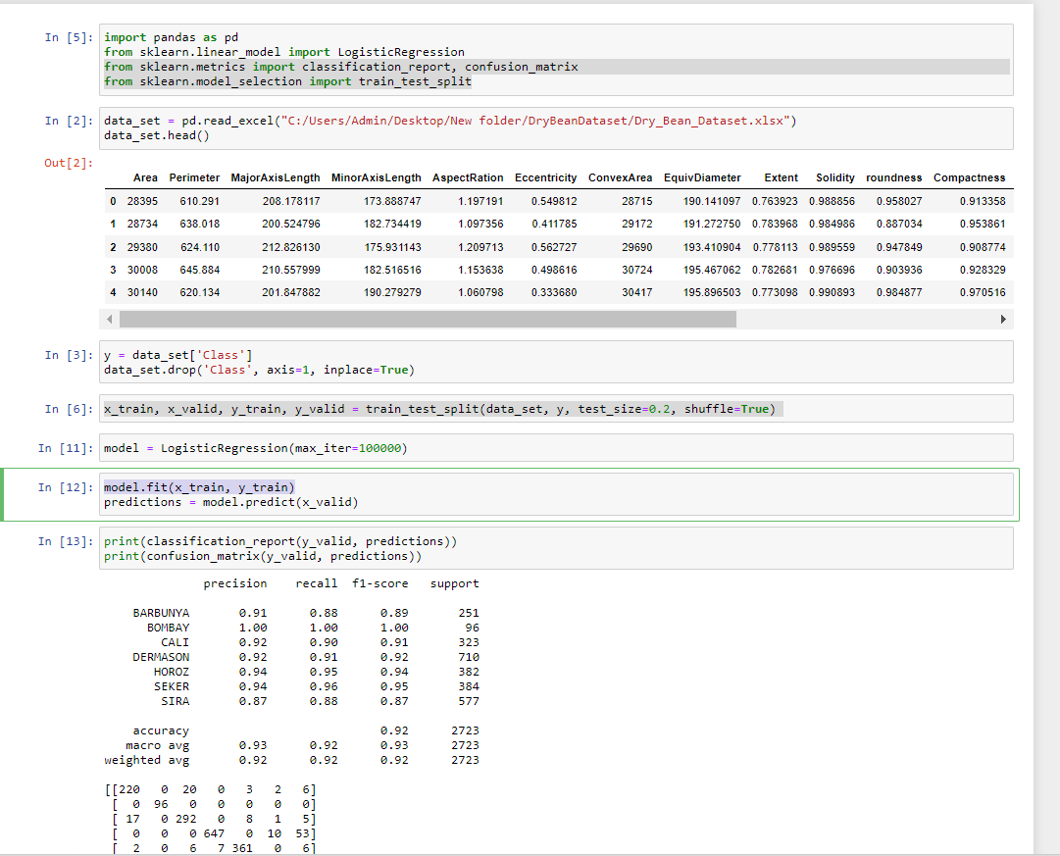
Results and Discussion -Logistic regression

Slide 11
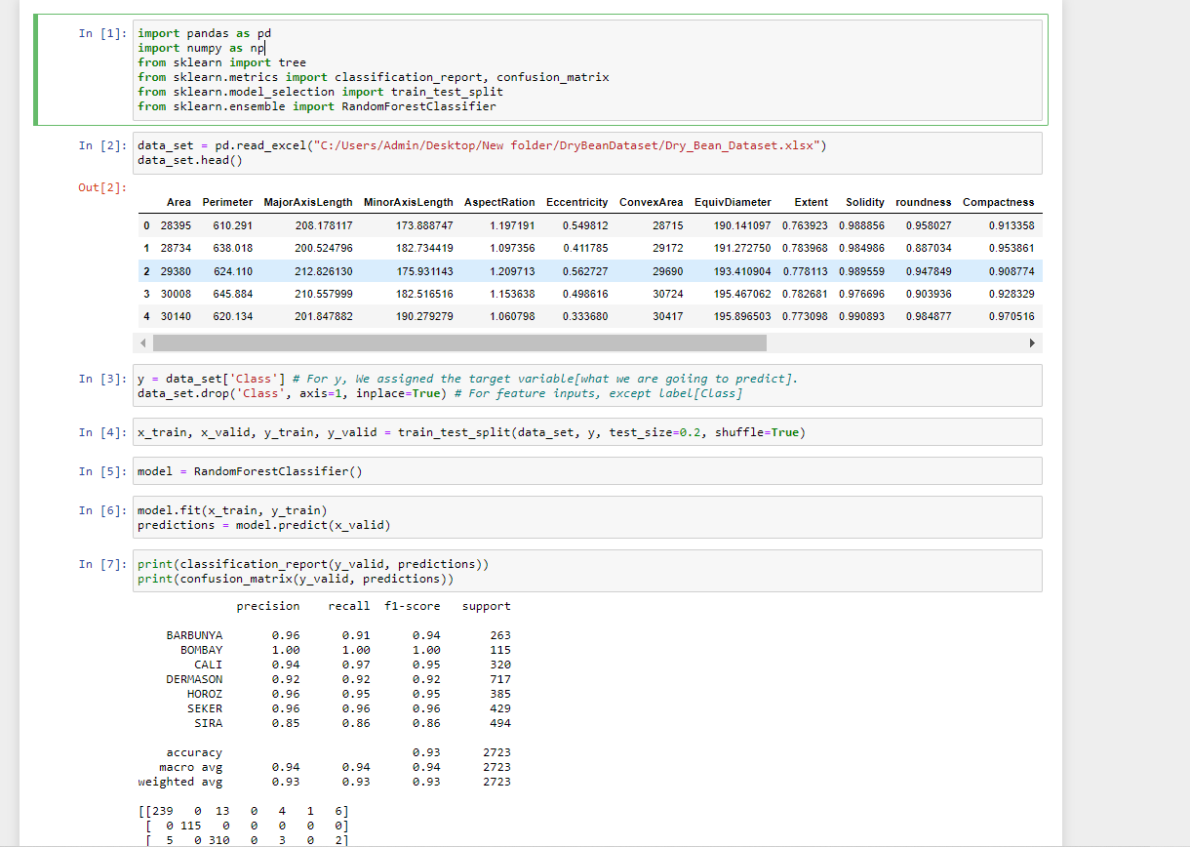
Results and Discussion- Random forest classifier

Slide 12
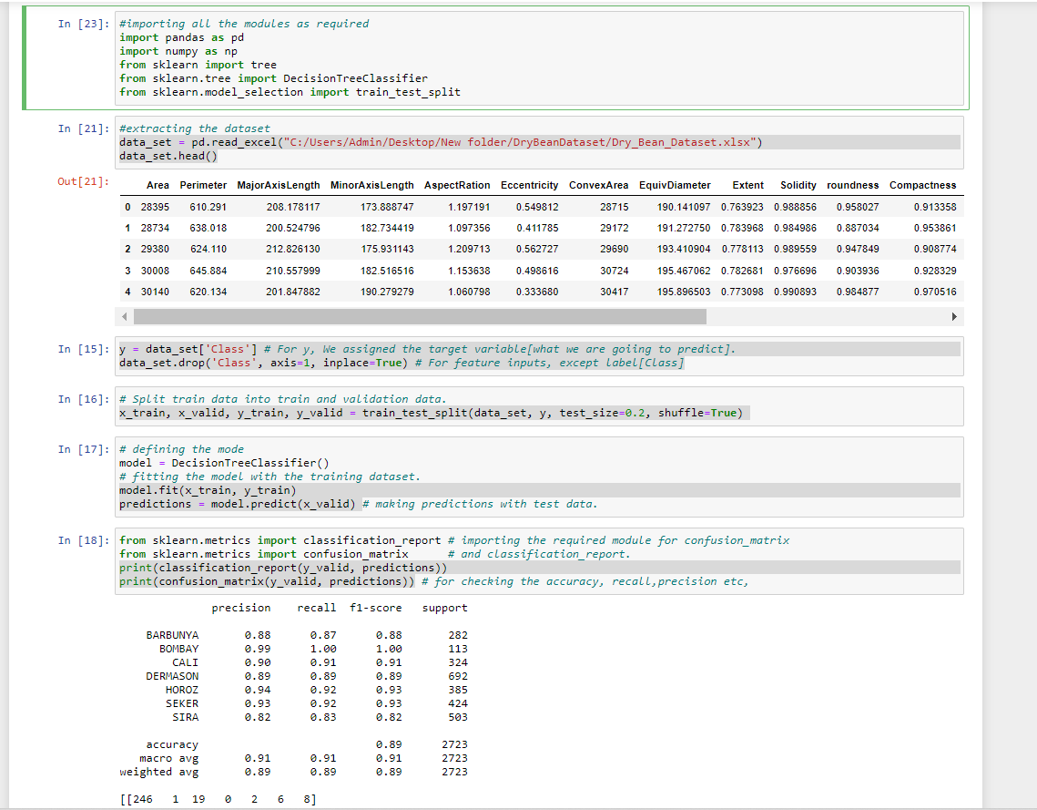
Results and Discussion-Decision treeclassifier

Slide 13
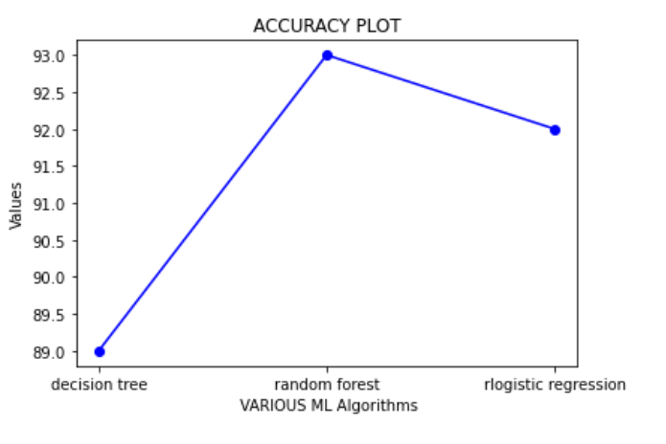
Results and Discussion-Accuracy line plot

Slide 14
Conclusion
By using decision tree classifier, logistic regression and random forest classifier, we get the accuracy as 89% , 92% and 93% respectively.
So we can conclude that random forest classifier gives the best accuracy.
We have successfully established the Dry Bean classification of system.

Slide 15
References
[1] | KOKLU, M. and OZKAN, I.A., (2020), â€œMulticlass Classification of Dry Beans Using Computer Vision and Machine Learning Techniques.â€ Computers and Electronics in Agriculture, 174, 105507. DOI: [Web Link]
[2] | A. Vibhute, S. Bodhe Computer Science (2012) Applications of Image Processing in Agriculture:
[3] | Jun Sun, Shuying Jiang, H. Mao, Xiaohong Wu, Qinglin Li Materials Science (2016) Classification of Black Beans Using Visible and Near Infrared Hyperspectral Imaging.
[4] | T. Mitchell, ―Machine Learning‖, McGraw Hill, 1997.

